Slide 1
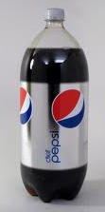
Matter
Solids Liquid & Gas
The Diet Pepsi & Mentos
Experiment

Slide 2
Hypothesis
Some of our friends where familiar with the experiment. Here are some hypothesis from the children who had never seen the experiment before.
“I think when the candy goes into the soda it will sink.”
“I think it’s going to turn into a solid.”
“I think the candy will have gas in it.”
“I think it will sink when it goes in the soda.”
“I think the candy will dissolve when it goes into the soda.”
“I think the soda will pop when the candy goes in.”
“I think that the soda is going to pop up somehow.”
“I think it’s going to keep it’s shape.

Slide 3
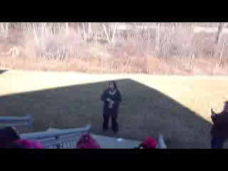
The Experiment

Slide 4
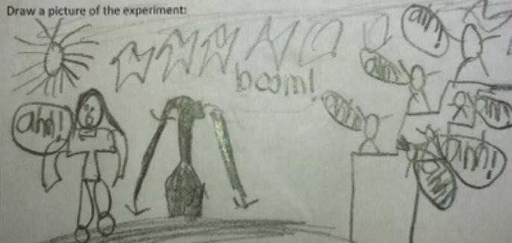
What happened
The gas bubbles in the liquid were in a mad rush to attach themselves to the candy. There was more room outside the bottle than inside so they all rushed out in a mad stampede!

Slide 5
Conclusion
Some of our friends where familiar with the experiment. Here are some conclusions from the children who had never seen the experiment before.
“I got it wrong because it splat out - not sink.”
“I was wrong. It didn’t turn into a solid. It exploded.”
“I don’t know if my hypothesis [was right] the gas is out.”
“When the candy was in the bottle the Pepsi exploded.”
“When the candy went into the soda it popped. I was not right.”
“I was wrong. The gas in the soda exploded because of the candy.”
“The soda did pop up. The candy made the gas in it pop up.”
“I didn’t get it right but it was fun too! I liked it!”

